Slide 1
A bit more on smart contract

Slide 2
Bitcoin scripts in practice (as of 2014)
Most nodes whitelist known scripts
99.9% are simple signature checks
~0.01% are MULTISIG
~0.01% are Pay-to-Script-Hash
Remainder are errors, proof-of-burn
More on this soon
How about today? Any changes? Why or why not? … final project
https://www.blockchain.com/explorer
Notes:
Miners might refuse to run “non-valid” scripts

Slide 3
Proof-of-burn
nothing’s going to redeem that ☹
OP_RETURN
<arbitrary data>
Notes:
Uses: spam/griefing. Transfer to another cryptocurrency. Fidelity bond

Slide 4
Should senders specify scripts?
?
Big Box
I’m ready to pay for my purchases!
Cool! Well we’re using MULTISIG now, so include a script requiring 2 of our 3 account managers to approve. Don’t get any of those details wrong. Thanks for shopping at Big Box!
Bitcoin has a clever solution to this problem, and it applies to not just multi-sig addresses but to any complicated condition governing when coins can be spent. Instead of telling the sender “send your coins to the hash of this public key”, the receiver can instead tell the sender “send your coins to the hash of this script. Bitcoin Wiki

Slide 5
Idea: use the hash of redemption script
<signature>
<<pubkey> OP_CHECKSIG>
<signature>
<pubkey>
OP_CHECKSIG
OP_HASH160
<hash of redemption script>
OP_EQUAL
“Pay to Script Hash”

Slide 6
Pay to script hash
Big Box
I’m ready to pay for my purchases!
Great! Here’s our address: 0x3454

Slide 7
Applications of Bitcoin scripts
(simple ‘smart contracts’)

Slide 8
Example 1: Escrow transactions
(disputed case)
(normal case)
Pay x to Bob
SIGNED(ALICE, BOB)
Pay x to Alice
SIGNED(ALICE, JUDY)
Judy
To: Alice
From: Bob
PROBLEM: Alice wants to buy online from Bob. Alice doesn’t want to pay until after Bob ships.
Bob doesn’t want to ship until after Alice pays.
Alice
Pay x to 2-of-3 of Alice, Bob, Judy (MULTISIG)
SIGNED(ALICE)
Bob
Notes:
Gavel from OpenClipArt.com

Slide 9
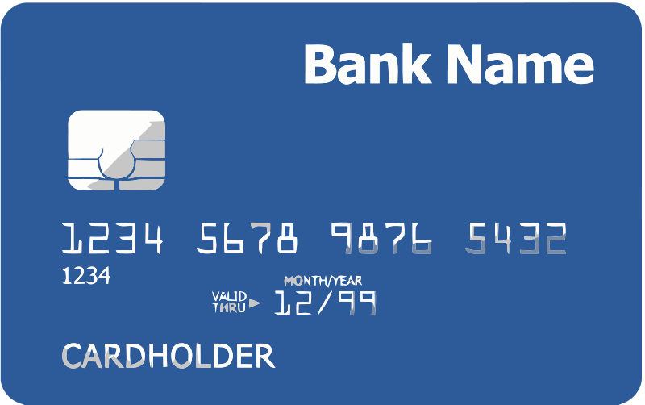
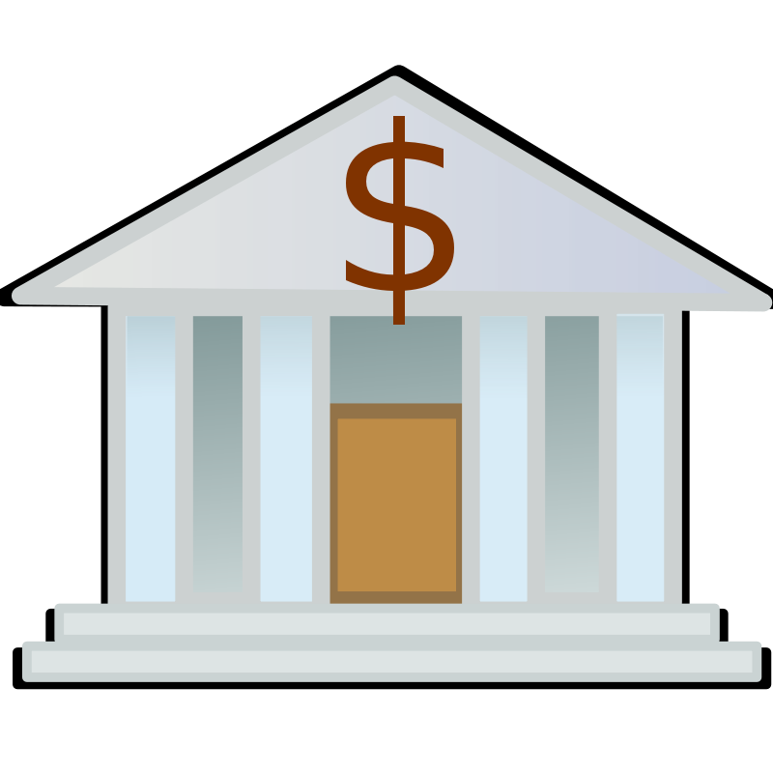
Example 2: Green addresses
004 days since last double spend!
It’s me, Alice! Could you make out a green payment to Bob?
Faraday cage
Bank
Pay x to Bob, y to Bank
SIGNED(BANK)
No double spend
Alice
PROBLEM: Alice wants to pay Bob.
Bob can’t wait 6 verifications to guard against double-spends, or is offline completely.
Bob
Notes:
These are mostly dead thanks to Mt. Gox, Instawallet

Slide 10
Example 3: Efficient micro-payments
What if Bob never signs??
Input: x; Pay 42 to Bob, 58 to Alice
SIGNED(ALICE) SIGNED(BOB)
all of these could be double-spends!
Input: x; Pay 42 to Bob, 58 to Alice
SIGNED(ALICE)___________
...
Alice demands a timed refund transaction before starting
Input: x; Pay 04 to Bob, 96 to Alice
SIGNED(ALICE)___________
Input: x; Pay 100 to Alice, LOCK until time t
SIGNED(ALICE) SIGNED(BOB)
I’m done!
I’ll publish!
Input: x; Pay 03 to Bob, 97 to Alice
SIGNED(ALICE)___________
Input: x; Pay 02 to Bob, 98 to Alice
SIGNED(ALICE)___________
Input: x; Pay 01 to Bob, 99 to Alice
SIGNED(ALICE)___________
PROBLEM: Alice wants to pay Bob for each minute of phone service. She doesn’t want to incur a transaction fee every minute.
Bob
Alice
Input: y; Pay 100 to Bob/Alice (MULTISIG)
SIGNED(ALICE)
Notes:
What if Bob never paid?

Slide 11
lock_time
{ "hash":"5a42590...b8b6b", "ver":1, "vin_sz":2, "vout_sz":1, "lock_time":315415, "size":404,
...
}
Block index or real-world timestamp before which this transaction can’t be published
lightning network; state channel…

Slide 12
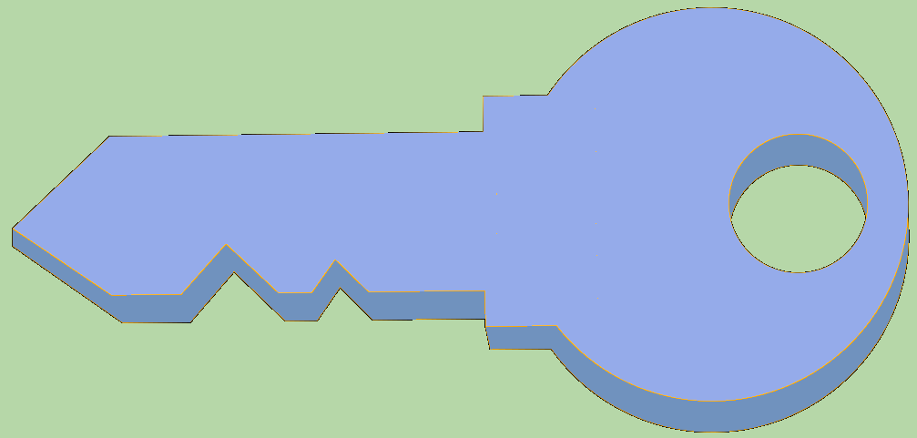
A bidirectional channel (Poon and Dryja 2016)
Pay 2 to Bob, 8 to Alice
SIGNED(ALICE)___________
Pay 2 to Bob, 8 to Alice
SIGNED(ALICE) SIGNED(BOB)
…
Pay 5 to Bob; 5 to a HTLC (Alice, LOCK until time t; or Bob with a one-time secret key from Alice)
___________ SIGNED(BOB)
Pay 5 to Alice; 5 to a HTLC (Bob, LOCK until time t; or Alice with a one-time secret key from Bob)
SIGNED(ALICE) ___________
HTLC: Hashed Time Lock Contract
Pay 4 to Bob; 6 to a HTLC (Alice, LOCK until time t; or Bob with a newer one-time secret key from Alice)
___________ SIGNED(BOB)
Pay 6 to Alice; 4 to a HTLC (Bob, LOCK until time t; or Alice with a newer one-time secret key from Bob)
SIGNED(ALICE) ___________
I’m done!
I’ll publish!
Pay 6 to Bob; 4 to a HTLC (Alice, LOCK until time t; or Bob with a new one-time secret key from Alice)
___________ SIGNED(BOB)
Pay 4 to Alice; 6 to a HTLC (Bob, LOCK until time t; or Alice with a new one-time secret key from Bob)
SIGNED(ALICE) ___________
Pay 5 to Alice/Bob (MULTISIG)
SIGNED(Bob)
PROBLEM: Alice and Bob are two roommates that constantly pay each other. They don’t want to incur a transaction fee for every payment.
Pay 5 to Alice/Bob (MULTISIG)
SIGNED(ALICE)

Slide 13
Two-way Payment Channel
https://www.youtube.com/watch?v=7tHD9Gj9UNg&feature=youtu.be
https://www.youtube.com/watch?v=k-bXIZOMNyA&t=228s
Relatedly, scaling solutions for blockchain: payment channel/lightning; sharding; side-chain layer 2 (e.g. Nervos, Plasma – dated, Rollups – zk/optimistic)

Slide 14
More advanced scripts
Multiplayer lotteries
Hash pre-image challenges
Coin-swapping protocols
Very relevant to anonymity solutions!
“Smart contracts”

Slide 15
A gentle introduction to Ethereum
Turing complete smart contracts
Gas

